Slide 1

By joey Tierney

Slide 2

What is “The Walking Dead?”
The Walking Dead is an American horror television drama, currently airing on AMC (America) and FOX (International)
Originally started as a comic book series, created by Robert Kirkman in 2003 and published by Image Comics
Both the show and the comics are based in Georgia
It’s not just about zombies – more about human survival
The TV series stars Andrew Lincoln as Rick Grimes, a police officer who gets shot in the line of duty and awakens from a coma to find a world inhabited by the walking dead

Slide 3
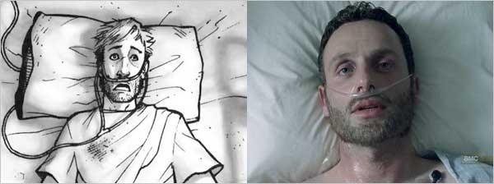
What’s the story?
Rick Grimes wakes up from a coma 60 days after the outbreak
He leaves the hospital, which is surrounded by dead bodies
He steals a bike and cycles his way home to find his family missing
He meets a fellow survivor named Morgan Jones, and his son Duane
After resting up, Rick takes guns from the police station and begins looking for his family

Slide 4
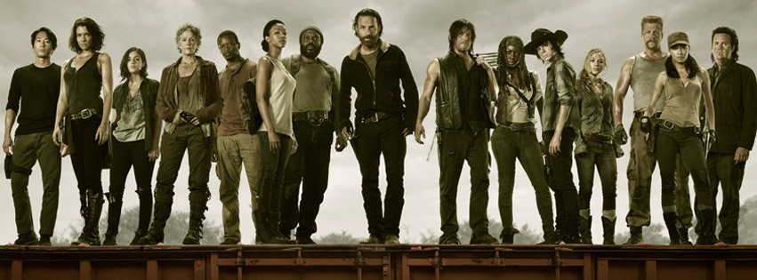
On his adventures, he encounters a group of survivors and becomes their leader

Slide 5
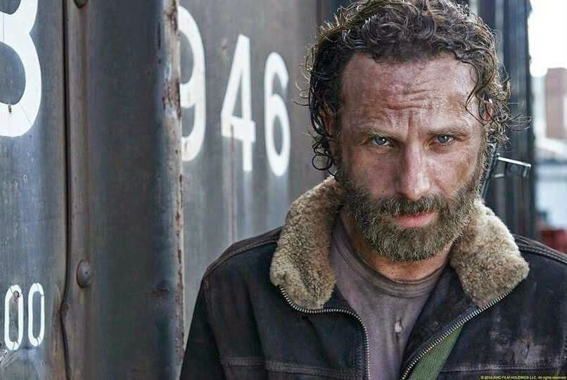
So, who is Rick Grimes?
He’s a former police officer
Leader of the Survivors
The “hero” of the story
Kind of unstable (spoilers)
Has a cool beard

Slide 6

The Governor
Played by David Morrissey
He’s the main antagonist
Volatile and depraved sociopath
Leader of a small town called Woodbury
Has one eye (for spoiler reasons, I can’t discuss why)
Personally, my favourite character

Slide 7
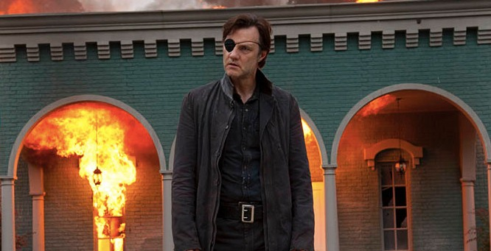

Slide 8

Any questions?

